Slide 1
A Pilot Study of the Caregiver Self-Management Program (CSMP)
Iris Chi, DSW
Chinese American Golden Age Association Frances Wu Chair for the Chinese Elderly
USC Suzanne Dworak-Peck School of Social Work Edward R. Roybal Institute on Aging
Hong Kong
December 1, 2018

Slide 2
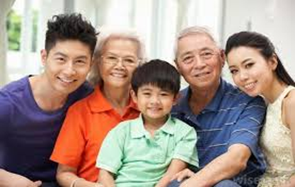
Content
1
Research Background
3
Preliminary Results
4
Current Work
2
Program Design
5
Future Plan

Slide 3
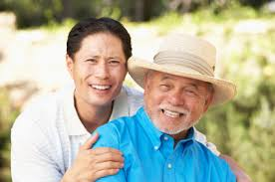
Research Background
Caregivers
Society increasingly demands caregivers
Caregiving is linked with an array of negative biopsychosocial symptoms
Interventions for immigrant caregivers are limited
Chinese Americans (CA)
Number of CA growing in a fast pace
Most older CA are foreign born
Chinese caregivers suffer from depression, anxiety disorders, and caregiving-related stress
Other challenges include navigating health care system and obtaining resources and support
Notes:
Due to an aging society and prolonged longevity, societal demands of caregivers has been skyroketing
Research indicates that care giving is linked with an array of negative biopsychosocial symptoms in caregivers, including but not limited to chronic stress, depressive symptoms, impaired cognition, declining health, financial hardships, etc.
So far, interventions targeting caregivers are very limited

Slide 4
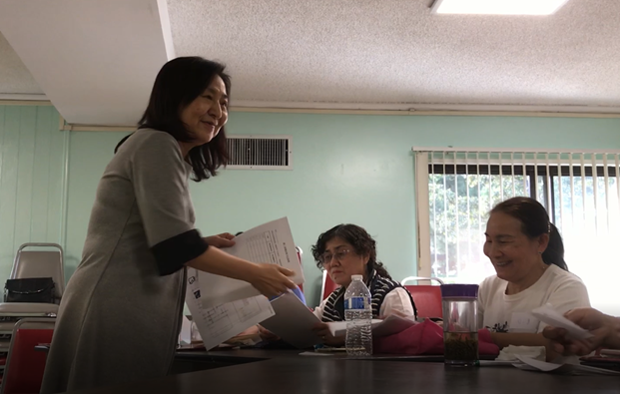
Program Goal
To design and test a culturally and linguistically appropriate self-management training program to enhance health and well-being, for CA caregivers

Slide 5
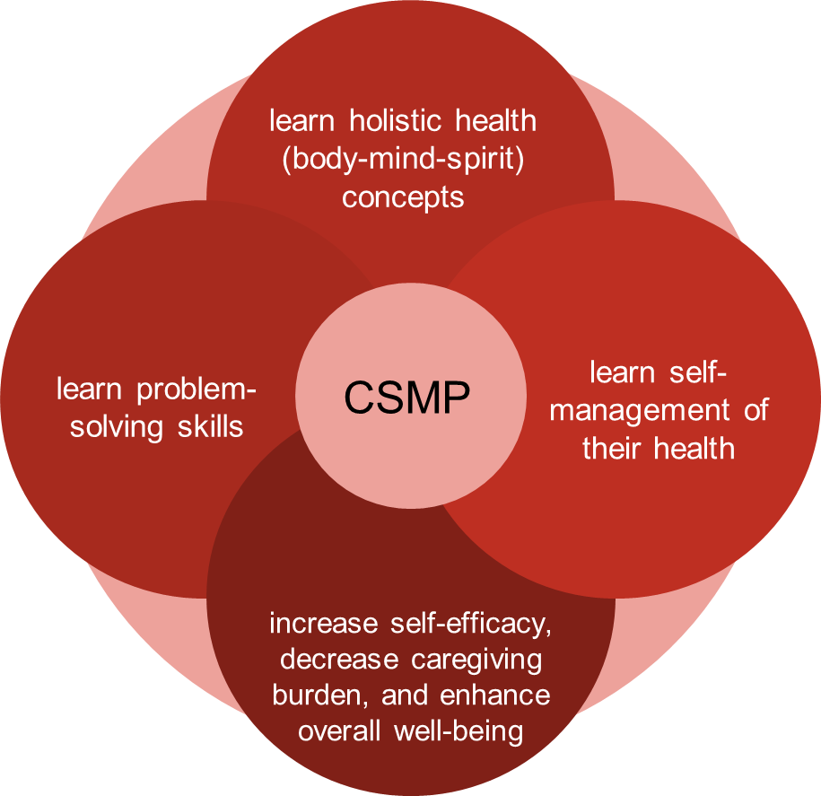
Program Objectives and
Expected Outcomes

Slide 6
Program Design: Guiding Theory
Body-Mind-Spiritual (BMS) Model
Professor Cecilia Chan, HKU
Evidence-based
BMS is rooted in Eastern philosophies
The yin-yang balance perspective
Daoism, Buddhism
Traditional Chinese Medicine health
BMS Health Self Help Handbook
Developed by Adrian Wan, CBH, HKU

Slide 7
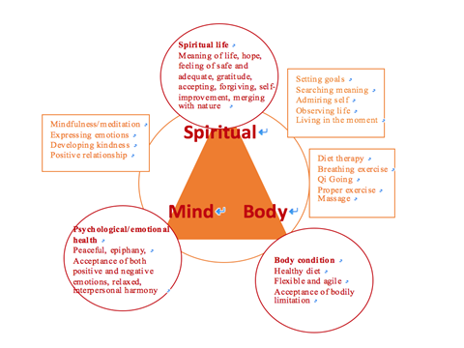
Intervention
This model regards the physical (body), emotional (mind) and spiritual (spirit) as indivisible yet distinctly different aspects of the same reality
Notes:
Under the guidance of BMS model, various interventions were incorporated into the program:
Meditation, breathing exercise, acupressure massage, physical exercises, etc.
Health literacy
Problem-solving therapy (PST)

Slide 8
Curriculum
In-person training, a total of 12 hours, conducted in four 3-hour sessions over a four-week period
Session # | Mini lecture/Skill training/Discussion | Activity | Homework
1 | Understanding caregiver role and stress Understanding Body-Mind-Spirit (BMS) Caregiver Model Guidance to maintain holistic health | BMS exercise 1 (including breathing exercise) | BMS exercise 1, reading 1
2 | Introducing problem solving skills Steps to problem resolution Managing emotional health: Spirituality | BMS exercise 2 (including gratitude) | BMS exercise 1 & 2, reading 2
3 | Understanding chronic disease/illness and self-management of health Healthy behaviors: diet, exercise, sleep, etc. | BMS exercise 3 (including massage and meditation) | BMS exercise 1 & 2 & 3, reading 3
4 | Importance of seeking support Introducing community resources | BMS exercise 4 (including mindfulness) | Review all readings and do all exercises
Due to the time conflicts of lecturers, the actual course arrangements for two experiment groups are slightly different

Slide 9
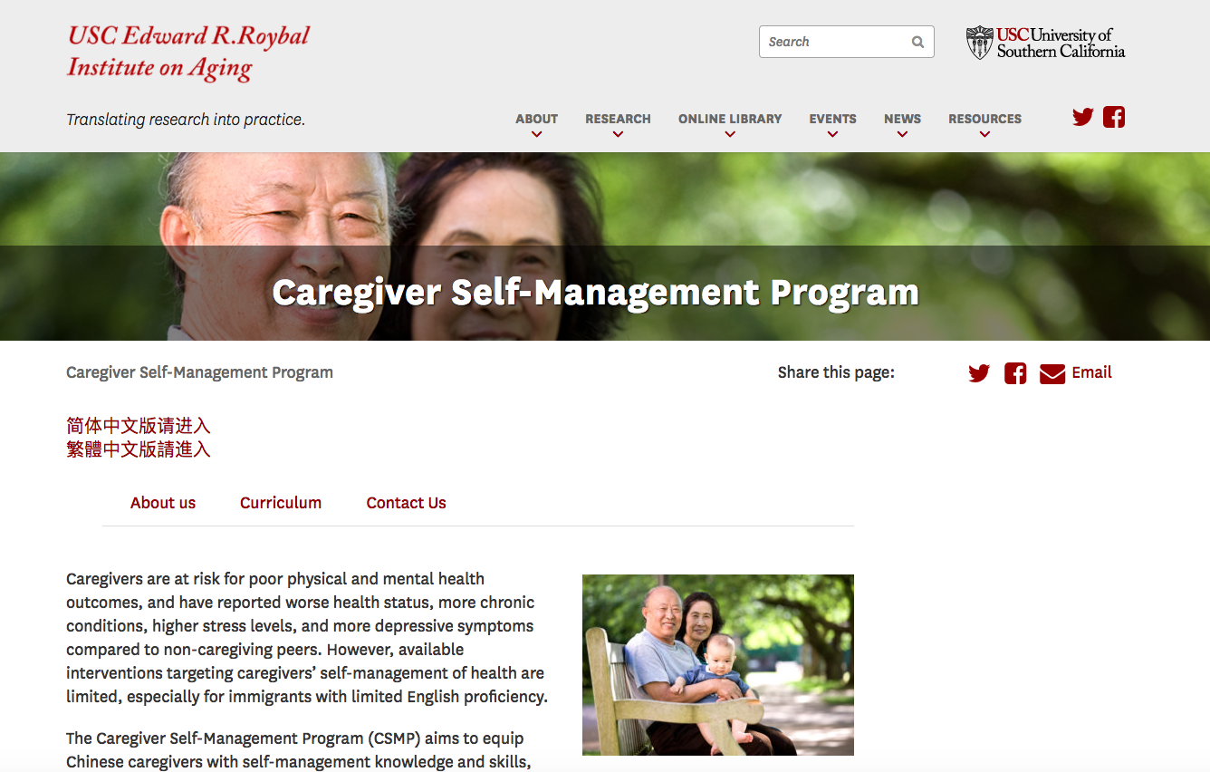
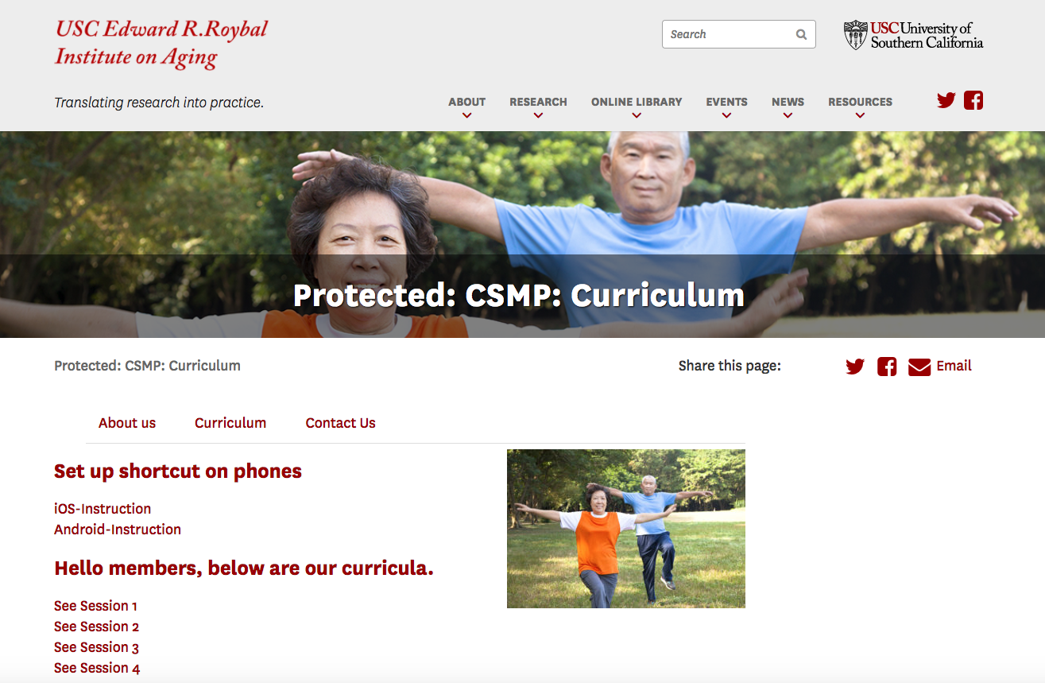
Technological Support
Bilingual manuals and exercise videos accessible on online training platform: https://roybal.usc.edu/csmp/
Text messages as reminders
Notes:
Teresa

Slide 10
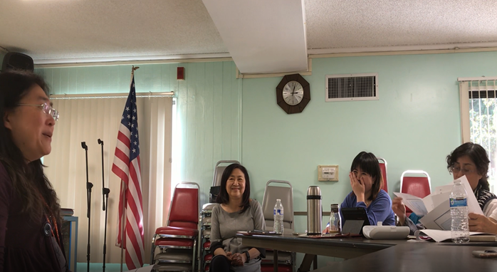
Research and Study Objectives
Formative Evaluation
Studies (program evaluation & focus group discussion)
Objectives
Develop the curriculum and training materials
Test the feasibility
Revision
Summative Evaluation
Effective study
Objectives
Determine the effect size
Inform and propose future studies
Notes:
Test the feasibility of implementing CSMP in practice
Identify areas which need adjustments, including content, strategies, and measures
Determine the effect size of the CSMP intervention
Generate evidence that guides future studies

Slide 11
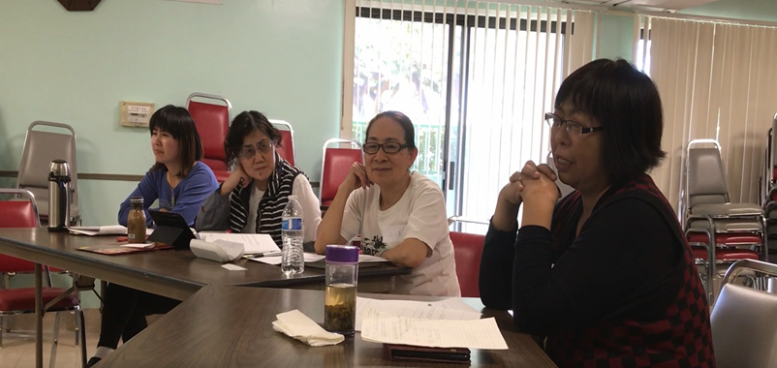
Participants
Chinese American caregivers with limited English proficiency and at lease one diagnosed chronic condition living in Los Angeles
Notes:
All subjects are Chinese American caregivers, with limited English proficiency and at lease one diagnosed chronic disease
68 eligible subjects in total, recruited from four(4) non-profit, community based organizations (CBO), including two adult day healthcare centers, one senior housing facility, and one social service and health clinic center
Sampling method: clustered randomized sampling

Slide 12
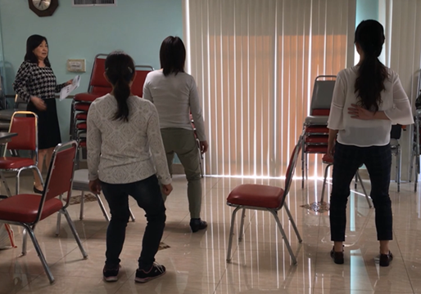
Study Sites and Sampling Method
Recruited from 4 community-based organizations (CBO)
Two adult day health centers,
One senior housing facility
One health and social service center
Screened for eligibility
Clustered randomized sampling
Two CBOs randomly assigned to intervention group (IG) while other two to control group (CG)
Notes:
All subjects are Chinese American caregivers, with limited English proficiency and at lease one diagnosed chronic disease
68 eligible subjects in total, recruited from four(4) non-profit, community based organizations (CBO), including two adult day healthcare centers, one senior housing facility, and one social service and health clinic center
Sampling method: clustered randomized sampling

Slide 13
Random assignment to IG and CG after screening for eligibility
Baseline Survey
IG: CSMP training
CG: Usual care
Formative Evaluation: Evaluation form,
Focus group discussion
Post-intervention Survey
(immediately after the program ends
Follow-up Survey
(3 months after the program ends)

Slide 14
Preliminary Results – Demographics
 | Mean (SD) or N (%)
Age (range: 44-90) | 70.8 (11.87)
Gender: Female | 52 (76.47)
Birthplace: Mainland China | 60 (88.23)
Years Living in U.S. (range: 3.0-40.0) | 17.8 (10.58)
Speak English: Yes | 48 (70.58)
Marital Status: Married | 62 (91.17)
Education High school and below Associate’s degree Bachelor's degree and above | 27 (39.70) 17 (25.00) 24 (35.29)
 | Mean (SD) or N (%)
Employment Status Employed full-time Employed part-time Not in labor force (retired, homemaker, student, etc.) | 17 (25.00) 4 ( 5.88) 47 (69.12)
Perceived Level of Financial Adequacy Difficult All right Comfortable | 6 ( 8.82) 56 (82.35) 6 ( 8.82)
Type of Housing Rental apartment, senior housing House or condominium | 41 (60.30) 27 (39.70)
Living with others | 68 (100.00)

Slide 15
Post-intervention Evaluation Results
Notes:
Teresa

Slide 16
Focus Group Discussion
Caregivers’ self-management of health is a new topic:
“This was the first time I learned how to care for my own physical and mental health.” (F/48) “When I was in China, I’ve never heard about it. We always talked about how to care for the care recipient but not about caregivers’ health.” (F/54)
Notes:
Teresa

Slide 17
Spirituality is a new and helpful topic
“Before this I only paid attention to physical and mental health, but now is body, mind and spirit… Just now, the instructor talked about the spirituality and how to find someone to communicate with. If you believe in Jesus, you have God. You can also communicate with people… with friends. It’s very helpful.” (M/68)
Notes:
Teresa

Slide 18
Participants became aware of formal and informal resources:
“I didn’t really know how to release negative emotions in daily life. Now I’ve given guidance, informal resources, and formal resources. Even though I have yet to fully utilize these resources, I’m aware of them and I know society is caring for us.” (F/66)
Notes:
Teresa

Slide 19
Boundary issues:
“This is a belief of some Chinese people, thinking we (formal caregivers) are their servants.” (M/58) “I think they (clients) should be informed that even though this is a benefit from the government, they should use it properly. I can take care of the older adult because of my duties, but I should not help with his son, daughter, or daughter-in-law’s issues.” (F/52)
Notes:
Teresa

Slide 20
Suggestions from the Participants
Future training:
Topics could go deeper… The content of your lectures basically covers our life and work, but over time some of these topics will change and evolve, so (future topics) can include new knowledge and you can go a bit deeper. (F/45) Care recipients should receive training, too. (F/69)
More cases and solutions:
More specific cases, solutions, and by what means or approaches to solve... For example, the conflicts between the client and us, what the trigger is, what will be the solution and who to ask for help… I think these are important. (M/72)
Notes:
Teresa

Slide 21
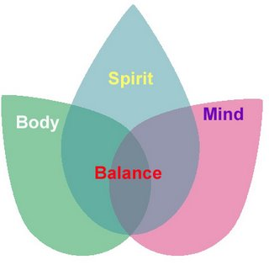
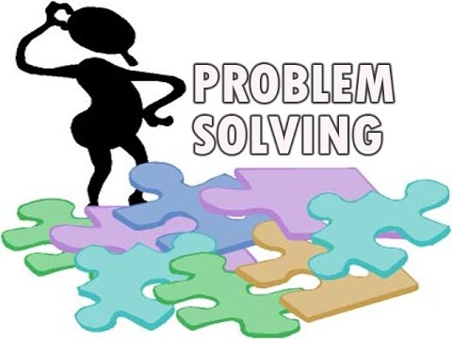
Preliminary Findings Summary
What are valued by caregivers?
Knowledge
Skills

Slide 22
Major Research Issues and Proposed Solutions
Recruitment
Issues: challenges including transportation, low motivations
Solutions: provide transportation and more training sites, training certificate
Scheduling
Issues: difficult for potential participants in coming to in-person group training at fixed date, time, and location
Solution: use IT online mode
Notes:
Recruitment:
Even with the support of community partners, we could only recruit a total of 35 participants within three months time
Challenges included availability of time, transportation limitations, and low motivation to participate (unaware of the importance of self-management)
Scheduling:
Difficulties for potential participants in coming to in-person training at fixed date, time, and location

Slide 23
Usage of Technology
Frequencies of Using Technologies to Search for Health Information
 | Daily | Weekly | Monthly or Less
Smart Phone (N=34) | 34 (100%)
Computer/Laptop (N=15) | 1 (6.67%) | 7 (47.78%) | 8 (53.33%)
Tablet/Pad (N = 34) | 28 (82.35%) | 6 (17.6%)
Notes:
Teresa

Slide 24
Current Ongoing Work
Quantitative Data Analysis
Complete 3-month follow-up measurements
Quantitatively analyze the efficacy
Innovative Integration of Technology
Develop an application for CSMP
Co-designed App Development
Step 1: User Participatory Co-design Approach
Step 2: Alpha-Testing of the CSMP App prototype
Step 3: Beta-Testing of the CSMP App prototype
Notes:
Quantitative Analysis
Complete the remaining 3-month follow-up measurements, and analyze the efficacy of CSMP using quantitative data
Innovative Integration of Technology
The research team plans to design an application for CSMP in order to help caregivers take the training anytime and anywhere and reach more caregivers
In addition to CSMP curriculum, new functions might cover:
Looking up disease knowledge
Locating peer support
Tracking health behaviors
Online tutoring
Push Notifications - The mobile app will push important notifications to encourage the caregivers or to remind the caregivers to take necessary actions

Slide 25
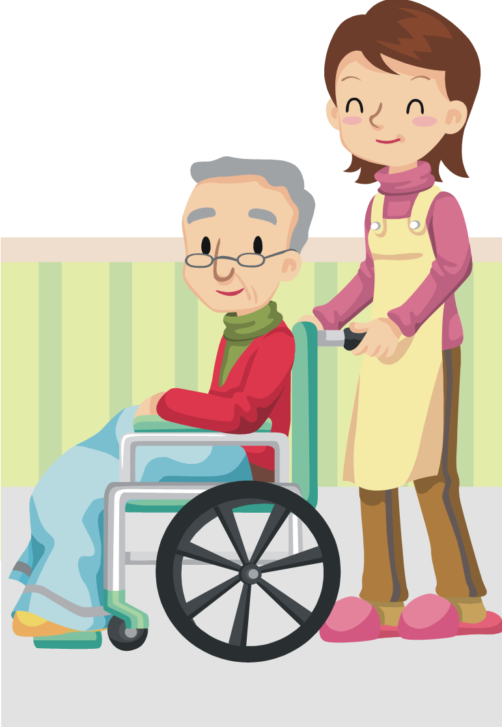
Preliminary Findings with Co-designers
How to make the app engaging to users?
Make it fun! e.g., Cartoon
Relevancy
Sharing
Notification
Customized content
Enabling search
Experiences as caregivers
Health knowledge
Learning goal setting
Reminders
Training certificates as rewards
Notes:
push notification
contents are delivered based on:
1. how many days joined
2. what he/she viewed
3. interests
4. …… (similar to Amazon)

Slide 26
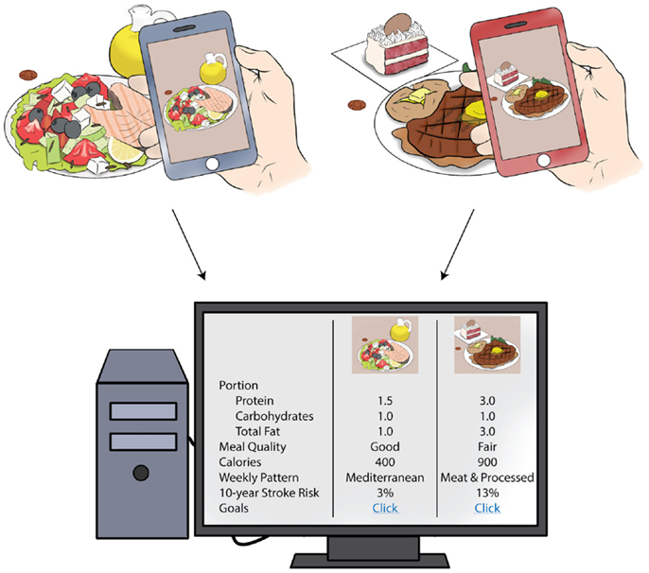
How to encourage health behavior?
Record health behavior and provide feedback
Online coaching
Notes:
push notification
contents are delivered based on:
1. how many days joined
2. what he/she viewed
3. interests
4. …… (similar to Amazon)

Slide 27
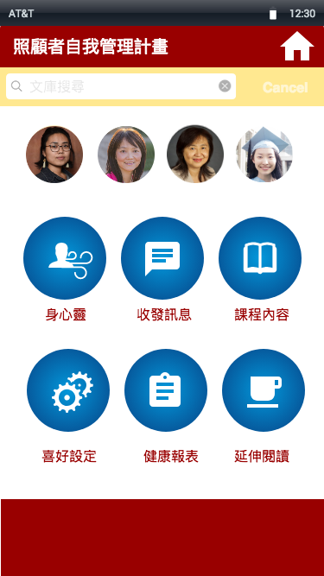
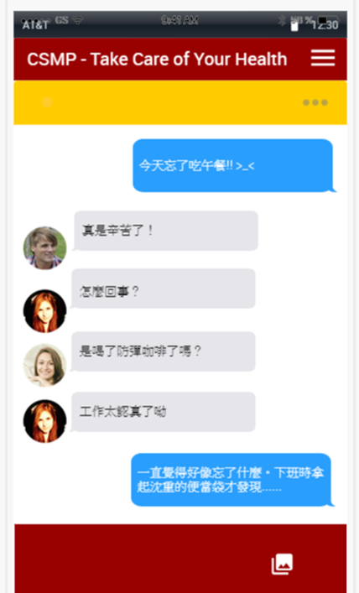
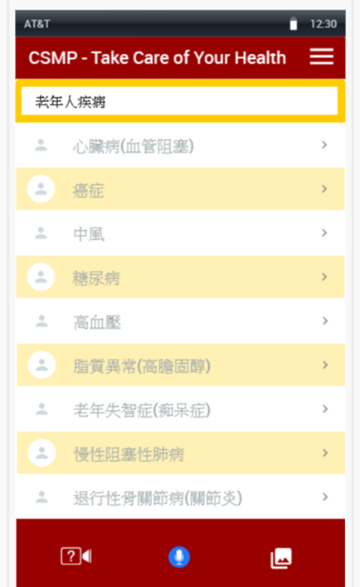
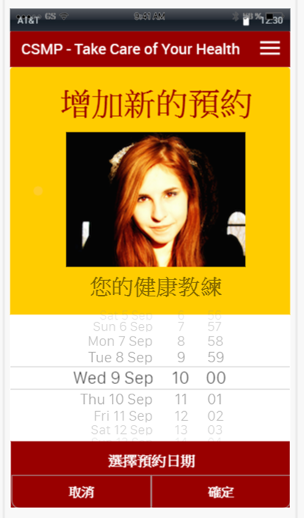
Functions besides the curriculum
Searching (e.g. disease knowledge)
Connecting peer support
Tracking health behaviors
Online coaching/tutoring
Push notifications, etc.

Slide 28
Future Work
Improve program and research design, including the Beta-Testing of the CSMP App prototype
Upgrade the research to a larger scale
Make comparison between in-person training, online training and control group
Notes:
Improve program and research design, including the Beta-Testing of the CSMP App prototype
Upgrade the research to a greater scale
Make comparison between in-person training, online training and control group

